Slide 1

Modeling Linear Regression using Gradient Descent
MAT 371: Introduction to Machine Learning
Dania Zein

Slide 2
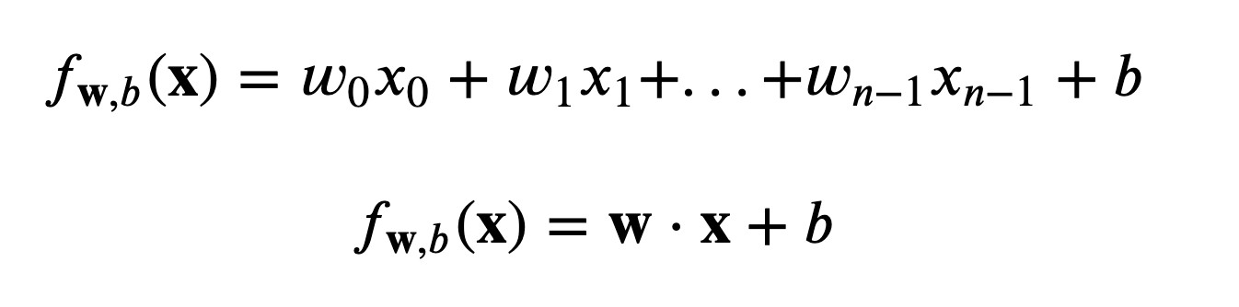
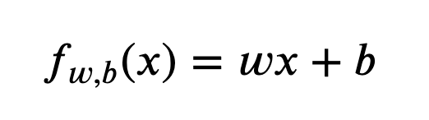
Linear Regression Overview
Linear Regression Model is a type of supervised learning regression model that fits a straight line to observed data
Learns from data including one or more features to predict a target output value using the “line of best fit”
Includes two parameters - “w” and “b”
The goal is to determine the best value for the two parameters so the linear equation fits the data as closely as possible
Single (Simple) Linear Regression - for each data point there is one feature (x^{i}) used to predict the output variable (y^{i})
Multiple Linear Regression - for each data point there are multiple features (x^{i}_{1,} x^{i}_{2,...}x^{i}_{n}) used to predict the output variable (y^{i})
Notes:
Supervised learning includes labeled data , with a given input and target output
Regression predicts a value
W = width, b = intercept
MLR x and w are vectors, w*x is a dot product

Slide 3
Scenario
Suppose you are the CEO of a restaurant franchise and are considering different cities for opening a new outlet.
You would like to expand your business to cities that may give your restaurant higher profits.
The chain already has restaurants in various cities and you have data for profits and populations from the cities.
You also have data on cities that are candidates for a new restaurant.
For these cities, you have the city population.
Can you use the data to help you identify which cities may potentially give your business higher profits?

Slide 4
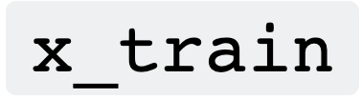

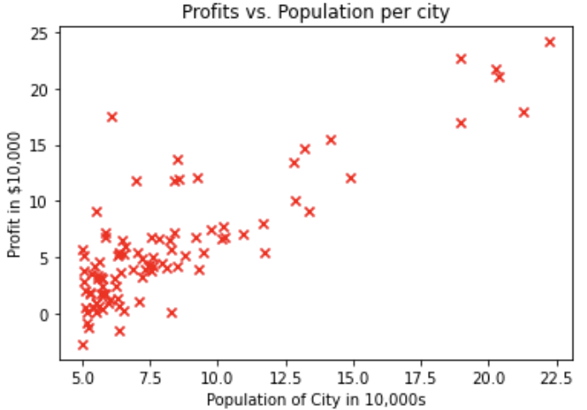
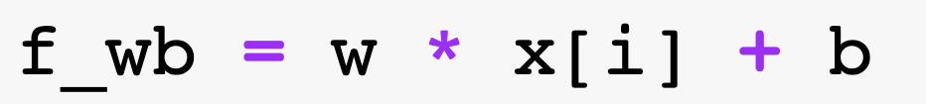
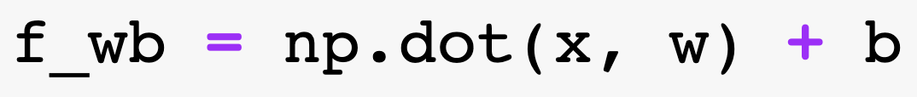
Linear Regression in Code
A Linear Regression model will use data from the training examples provided
and are numpy arrays
You can find the type and shape of the data provided
For this scenario, x_train is an array that holds the city populations for all training examples and y_train is an array that holds the profits for all training examples
Visualize the data provided in a scatter plot using matplotlib
Defining a single feature linear regression model:
D
Defining a multiple feature linear regression model:

Slide 5
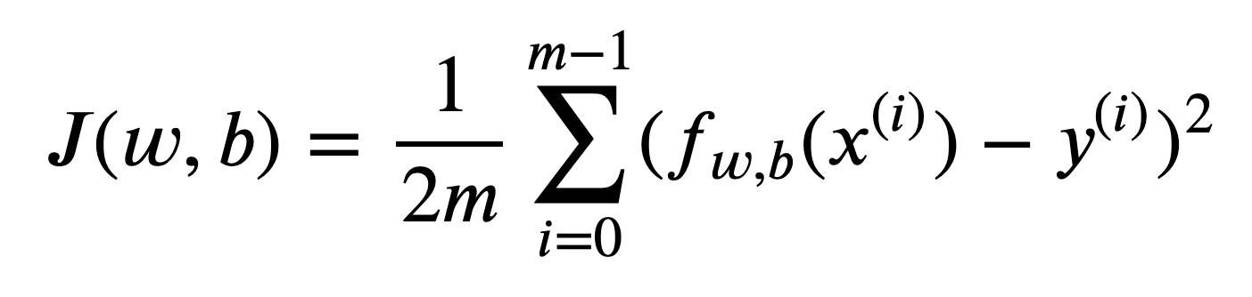
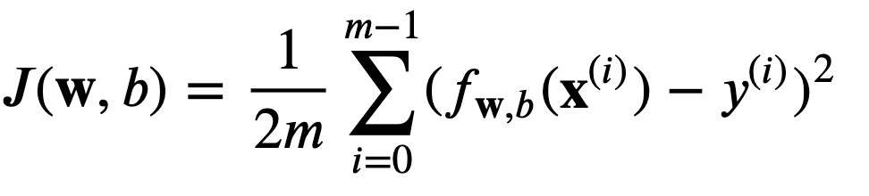
Loss Function
Training a linear regression model includes finding the best parameters (w,b) that fit the data
The loss Function is a function of parameters (w,b) that compares the prediction of the model to the actual target value
A loss function “measures the difference between the predicted values of the model and the actual target values”
The linear regression model uses a Squared Error Cost Function to determine loss
Single Feature
Multiple Feature
Notes:
To train a linear regression model, you want to find the best (𝑤,𝑏) parameters that fit your dataset.

Slide 6
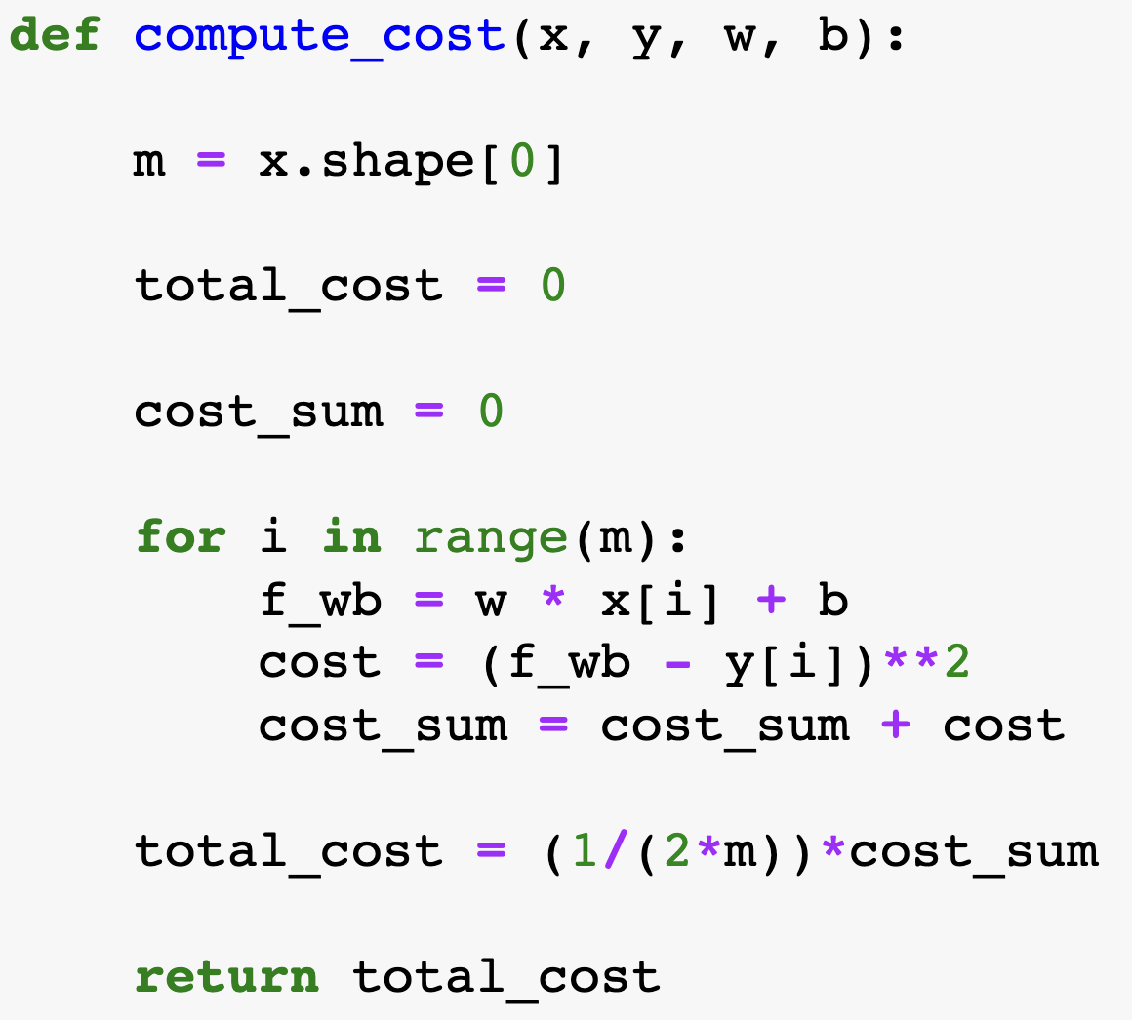
Computing the Cost Function for Linear Regression
Define a function for cost and include parameters
Define m as the number of training examples
Define the total cost to return
Define the sum of cost to continue adding onto
Use a for loop to iterate through each training example
Define the function for linear regression
Set cost equal to the difference between the model’s prediction and the actual value squared
Add the current cost to the sum of cost
Set the total cost equal to the average all costs
Return the total cost

Slide 7
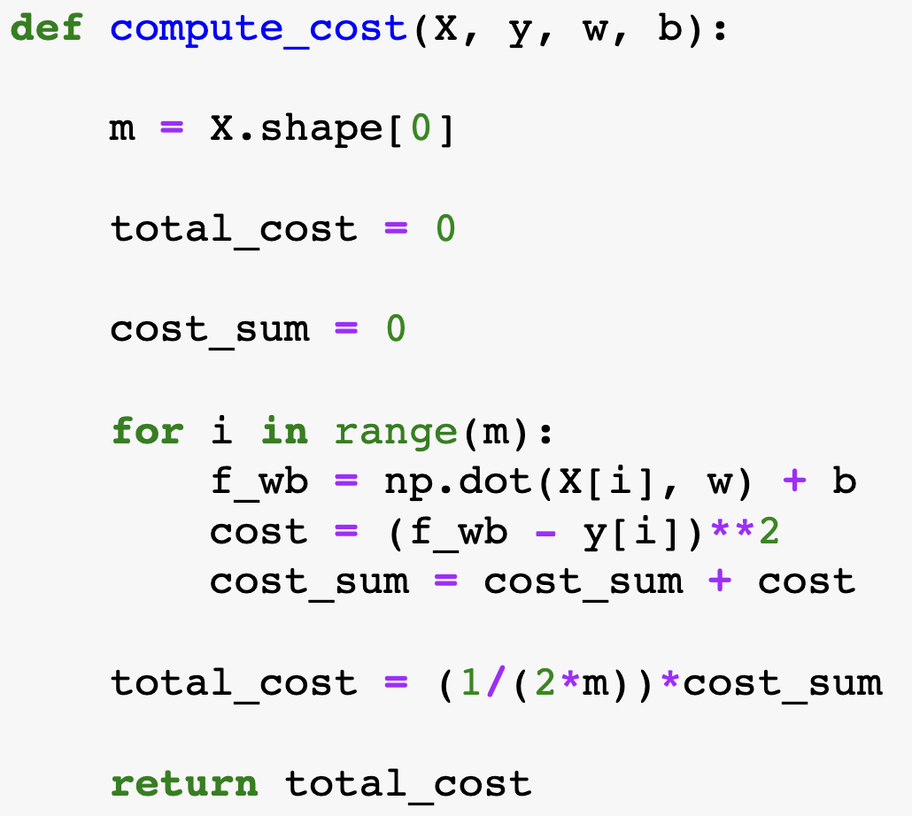
Computing the Cost Function for Multiple Linear Regression
Define a function for cost and include parameters
Define m as the number of training examples
Define the total cost to return
Define the sum of cost to continue adding onto
Use a for loop to iterate through each training example
Define the function for multiple linear regression
Set cost equal to the difference between the model’s prediction and the actual value squared
Add the current cost to the sum of cost
Set the total cost equal to the average all costs
Return the total cost

Slide 8
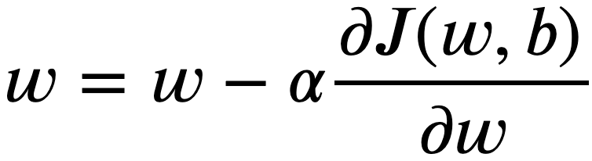
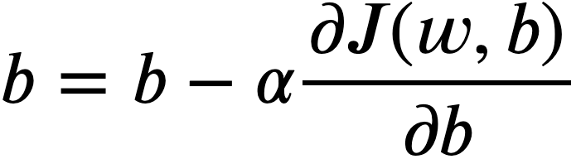
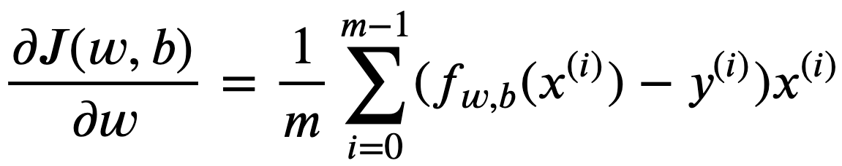
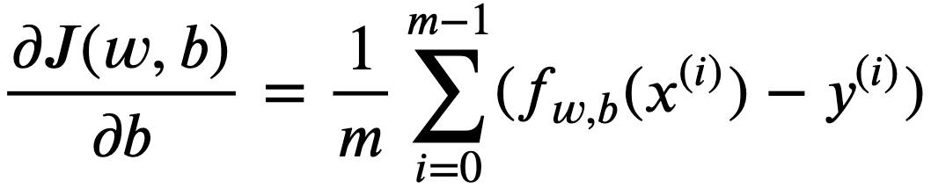
Understanding Gradient Descent
Gradient descent is an optimization algorithm that is used to find minimum of a differential function
Once a model has been trained, Gradient descent is used optimize the model
Gradient descent in machine learning is used to find the values of a function's parameters (w,b) that minimize the cost function as far as possible.u
It includes simultaneously updating parameters (w,b)
Notes:
New parameter = old parameter minus learning rate times the derivative of the cost function
Derivative of the cost function can be taken by tangent line,
if the slope is positive the next step is to move left
If the slope is negative the next step is to move right

Slide 9
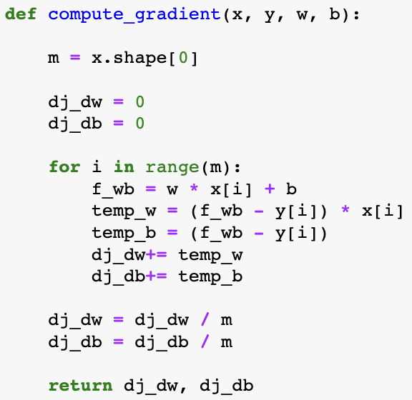
Computing the Gradient for Linear Regression
Define a function for gradient and include parameters
Define m as the number of training examples
Define the derivatives of cost with respect to the parameters (w,b)
Use a for loop to iterate through each training example
Define the function for linear regression
Set the temporary derivatives of cost equal to the difference in the model at that position
Update the parameters with the current value
Divide the derivatives by the total number of training examples
Return the total gradient update

Slide 10
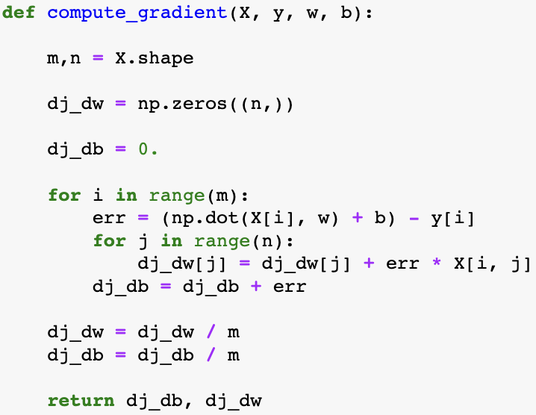
Computing the Gradient for Multiple Linear Regression
Define a function for gradient and include parameters
Define m as the number of training examples
Define the derivatives of cost with respect to the parameters (w,b)
Use a for loop to iterate through each training example
Define the temporary derivative of cost with respect to b
Use a for loop to iterate through each value of parameter w
Set the temporary derivatives of cost with respect to w
Update the parameters with the current value
Divide the derivatives by the total number of training examples
Return the total gradient update
Notes:
W is a vector

Slide 11
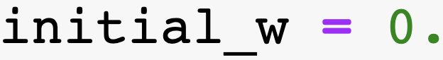
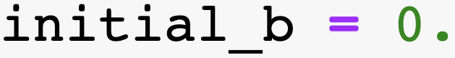
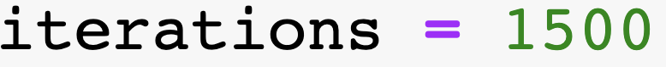



Implementing Linear Regression using Gradient Descent
To run gradient descent, initials values for parameters (w,b)
D
Set the number of times to run Gradient descent
B
Set the learning rate to some number
A
Define the gradient descent function & include parameters
B
Calculate the gradient and update the parameters using the gradient function
D
Update the parameters using the formula
D
Save the cost at each iteration to an array

Slide 12
Implementing Multiple Linear Regression using Gradient Descent
To run gradient descent, initials values for parameters (w,b)
D
Set the number of times to run Gradient descent
B
Set the learning rate to some number
A
Define the gradient descent function & include parameters
B
Calculate the gradient and update the parameters using the gradient function
D
Update the parameters using the formula
D
Save the cost at each iteration to an array

Slide 13
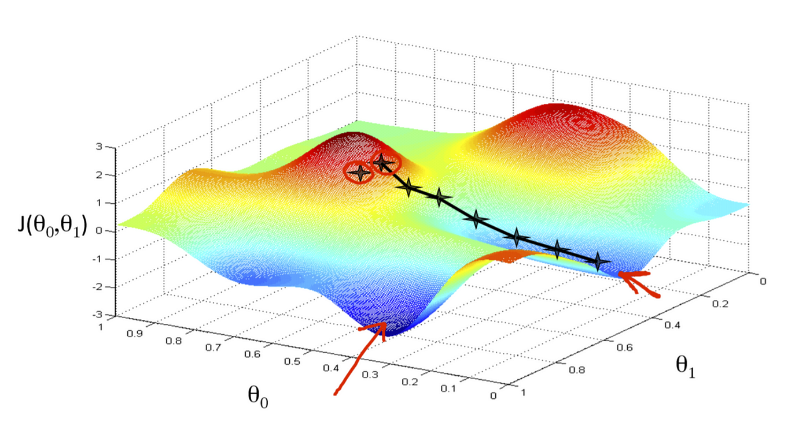
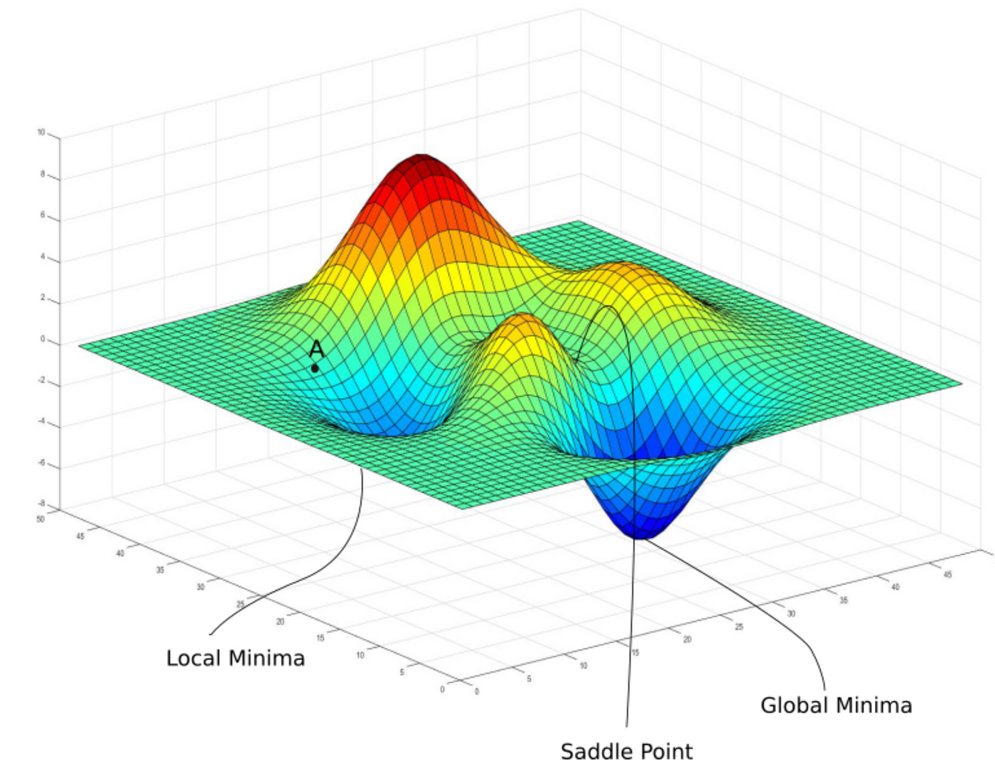
Troubleshooting
After each iteration, the Cost function should be decreasing
Gradient descent should take small steps in either direction and eventually converge
If a learning rate is too small or too large, the Cost function may never reach a minimum
Model bias occurs in a linear regression when the data does not have a linear relationship

Slide 14
Sources
Ng, Andrew. Supervised Machine Learning: Regression and Classification. Coursera, 2017, https://www.coursera.org/learn/machine-learning?specialization=machine-learning-introduction#outcomes.
Yen, Nhi. Understanding the Cost Function in Linear Regression for Machine Learning Beginners. Medium, 6 Aug. 2023, medium.com/@yennhi95zz/3-understanding-the-cost-function-in-linear-regression-for-machine-learning-beginners-ec9edeecbdde.
Bevans, Rebecca. Multiple Linear Regression | a Quick and Simple Guide. Scribbr, 20 Feb. 2020, www.scribbr.com/statistics/multiple-linear-regression/.
“ML | Bias vs Variance.” GeeksforGeeks, 6 Feb. 2020, www.geeksforgeeks.org/bias-vs-variance-in-machine-learning/.
Yadav, Pradyumna. “Journey of Gradient Descent — from Local to Global.” Medium, 26 Feb. 2021, medium.com/analytics-vidhya/journey-of-gradient-descent-from-local-to-global-c851eba3d367.
Shin, Terence. “An Intuitive Explanation of Gradient Descent.” Medium, 17 Jan. 2020, towardsdatascience.com/an-intuitive-explanation-of-gradient-descent-83adf68c9c33.

